Slide 1
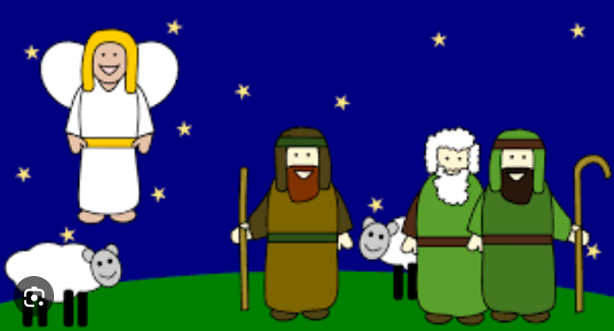
Crib Service at
St John’s Church
4.00pm on Christmas Eve
Join us for a short, happy Rhyming Nativity Play:
God’s Great Gift to All
Suitable for all ages.
Angels and Shepherds welcome!
At St John the Baptist Church, Wrotham Road, Meopham
DA13 0AA.

